Slide 1
R²IM: Reliable and Robust Intersection Management of Connected Autonomous Vehicles
Rachel Dedinsky
Thesis Defense – June 27th 2019
Committee: Dr. Aviral Shrivastava, Dr. Violet Syrotiuk, and Dr. Arunabha Sen

Slide 2
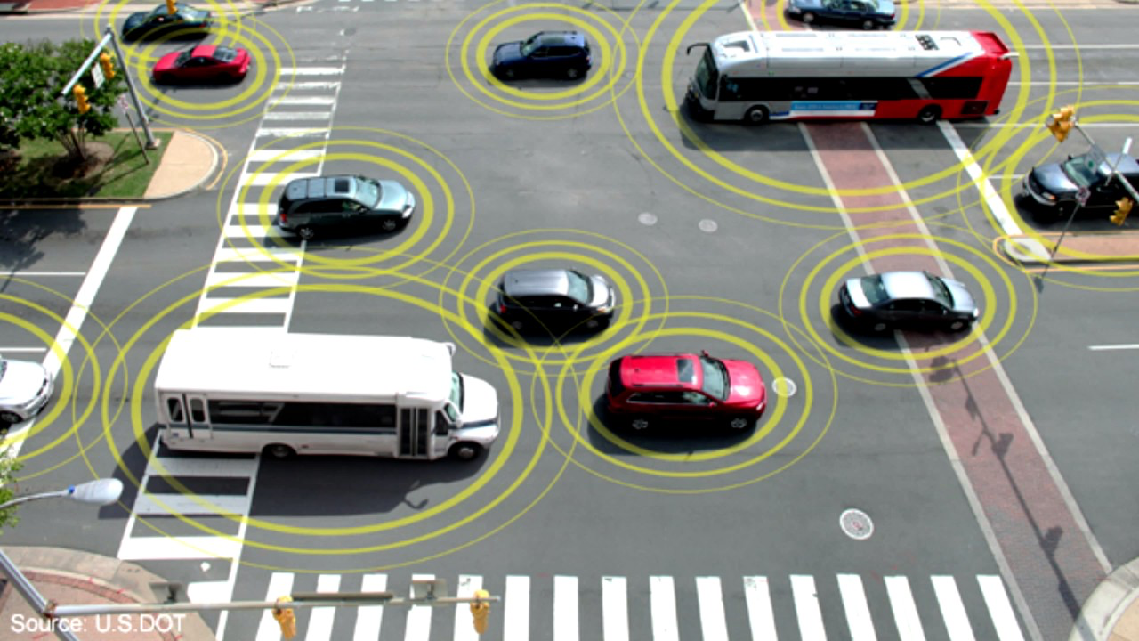
Intersection Management Importance
8,578 fatal crashes on average per year occurred within an intersection in the US between 2010 and 2017
Safe operation is largely dependent on the accuracy and precision of human drivers
Human error is inevitable
Solution
Autonomous, intelligent automotive transportation systems
Notes:
2nd part of autonomous, intelligent transportation systems are IMs.
70% of these fatal crashes caused by human error can be prevented by IM.
two priorities with autonomous transportation systems: efficiency and safety. Safety first, efficiency after.

Slide 3
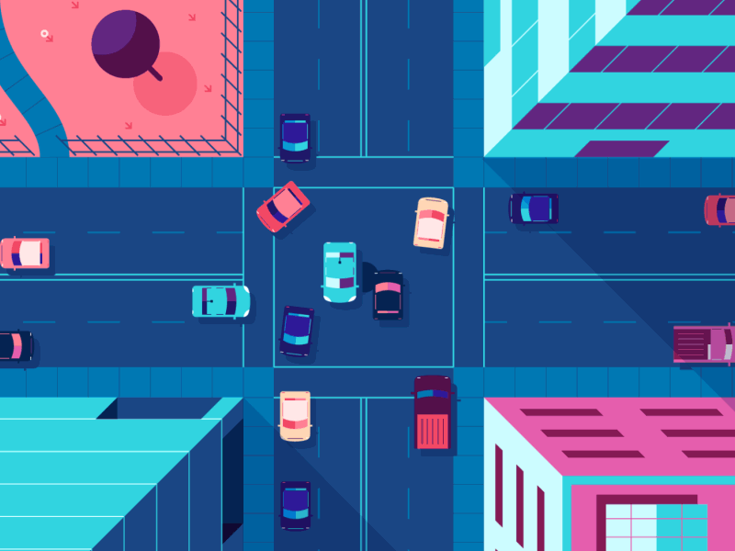
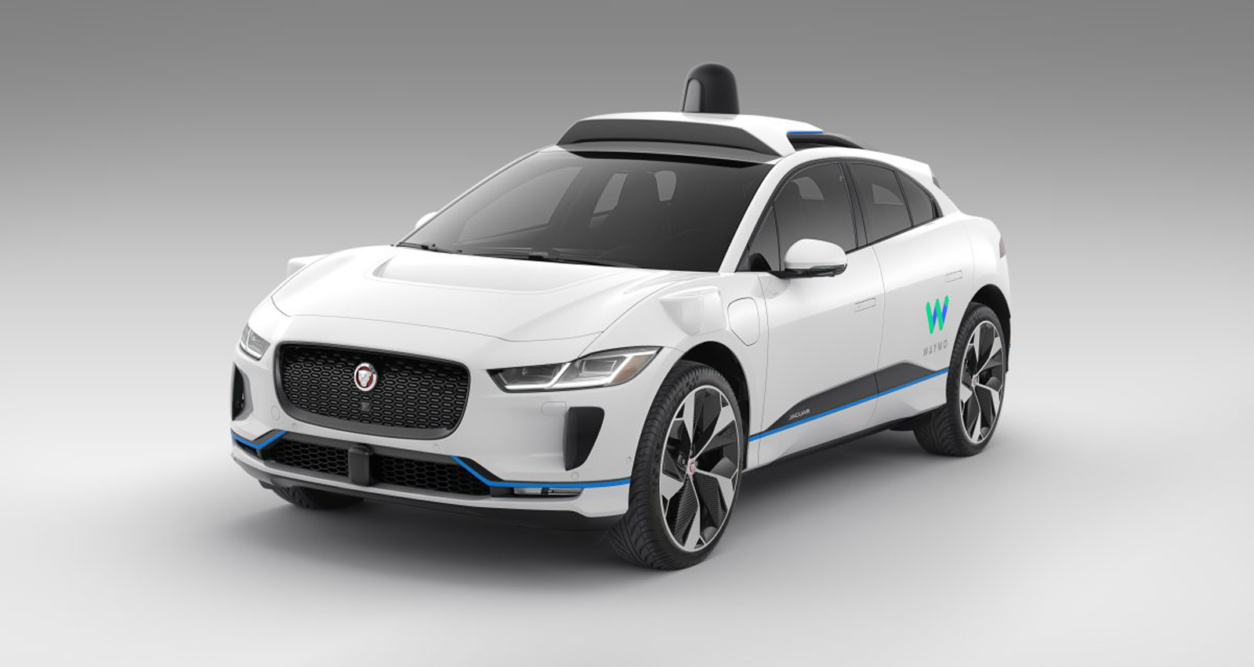
Intersection Managers
Intersection Managers(IMs) manage connected autonomous vehicles(CAVs)
Goal of IM
1) Improve safety and efficiency compared to typical traffic lights
2) Collect vehicle information
3) Guide vehicles through the intersection
Notes:
Much research has been done in the realm of IM.

Slide 4
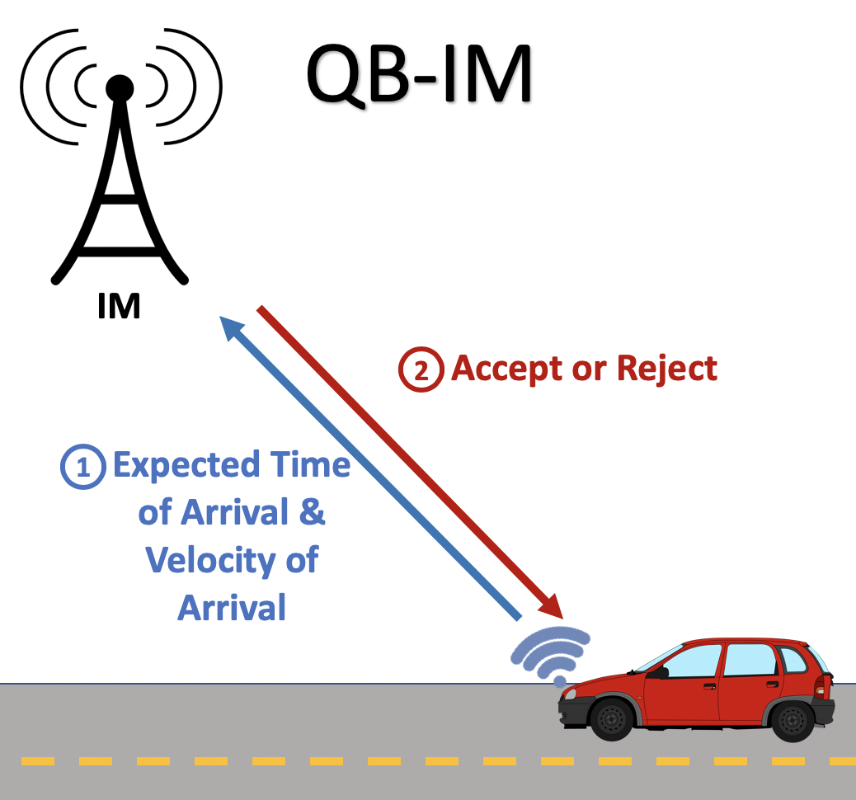
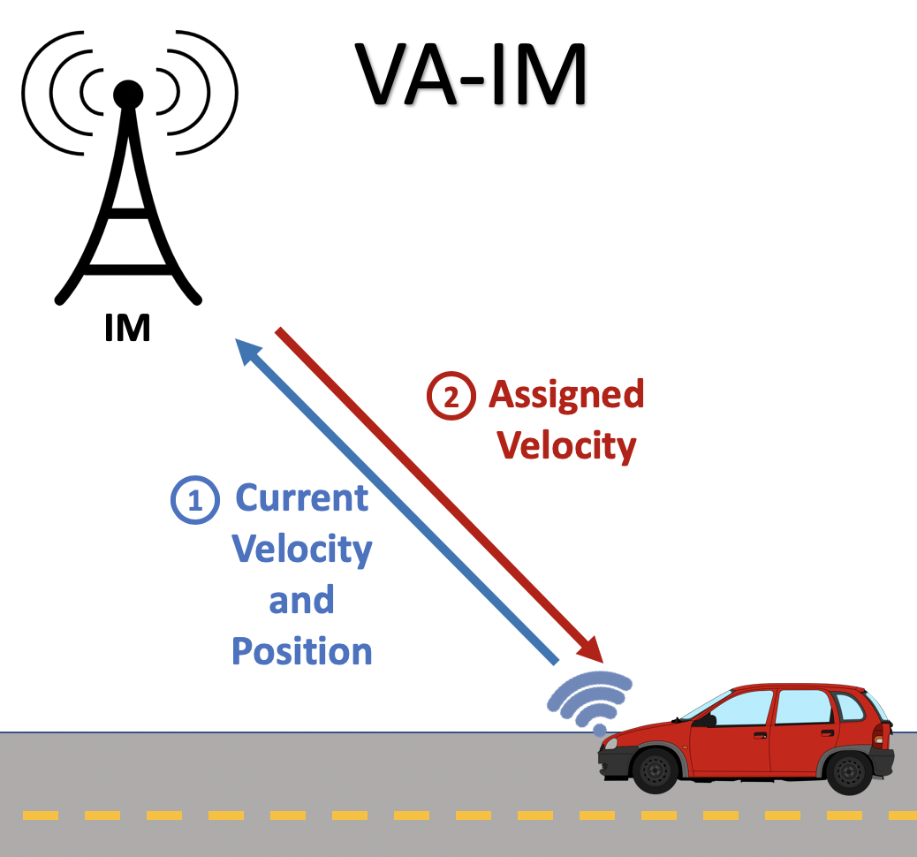
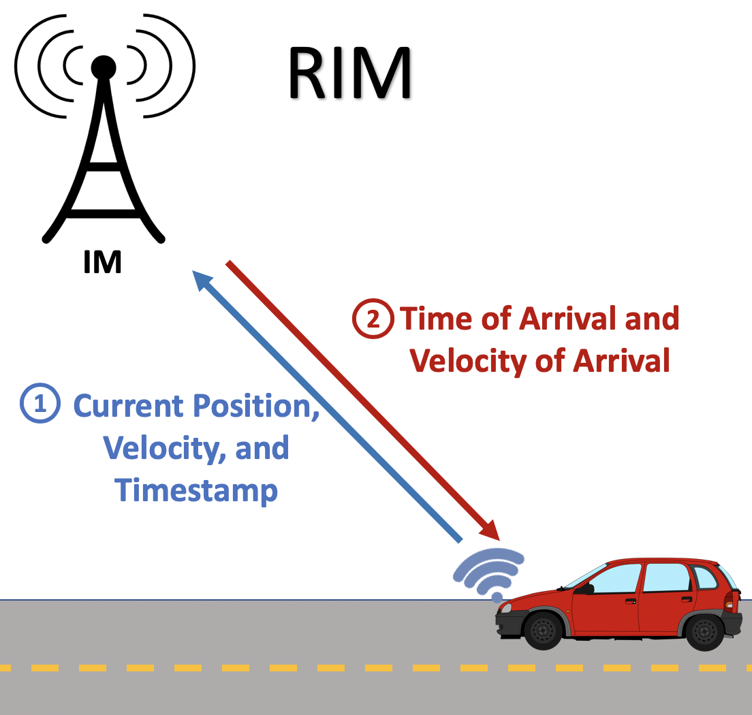
Related Work
Query-Based IM
Velocity-Assignment IM
Robust IM
Pros:
Easy feasible trajectory
computation
Cons:
High network traffic
Low throughput
External disturbance & model mismatch causes errors
Handle only ideal cases
Pros:
Low network overhead
High throughput
Cons:
External disturbance & model mismatch causes errors
Handle only ideal cases
Pros:
Handles external disturbances and model mismatches
Cons:
Handle only ideal cases
Notes:
help - VAIM
discuss model mismatch: behavior isn’t as expected because the considered vehicle model and the actual vehicle behavior are different
None of these were developed in the context of non-ideal cases occurring. Non-ideal cases are inevitable in cyber-physical systems and have to be considered.

Slide 5
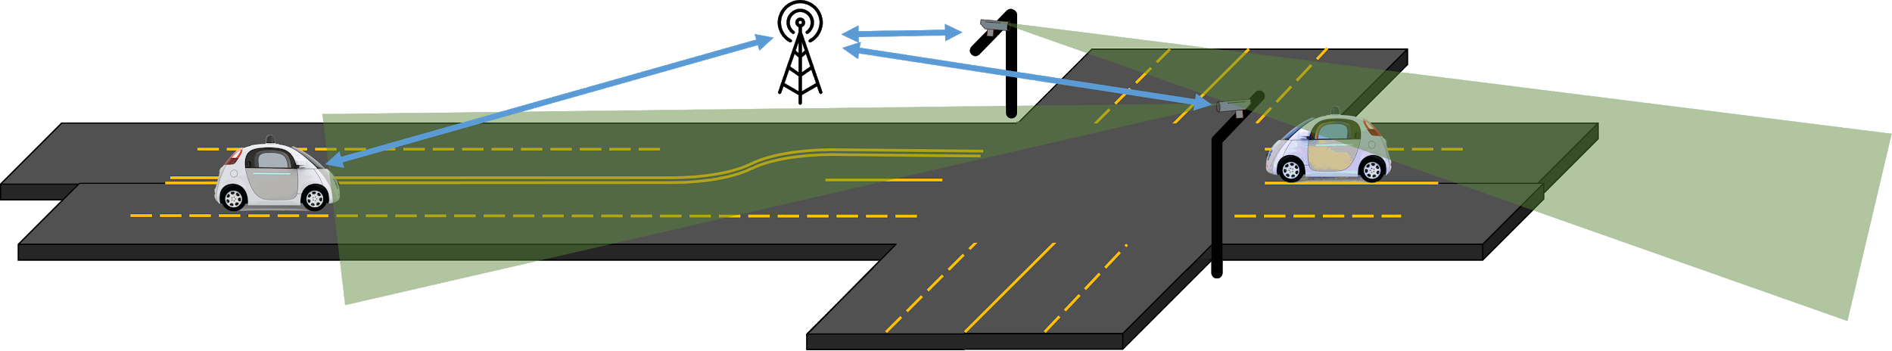
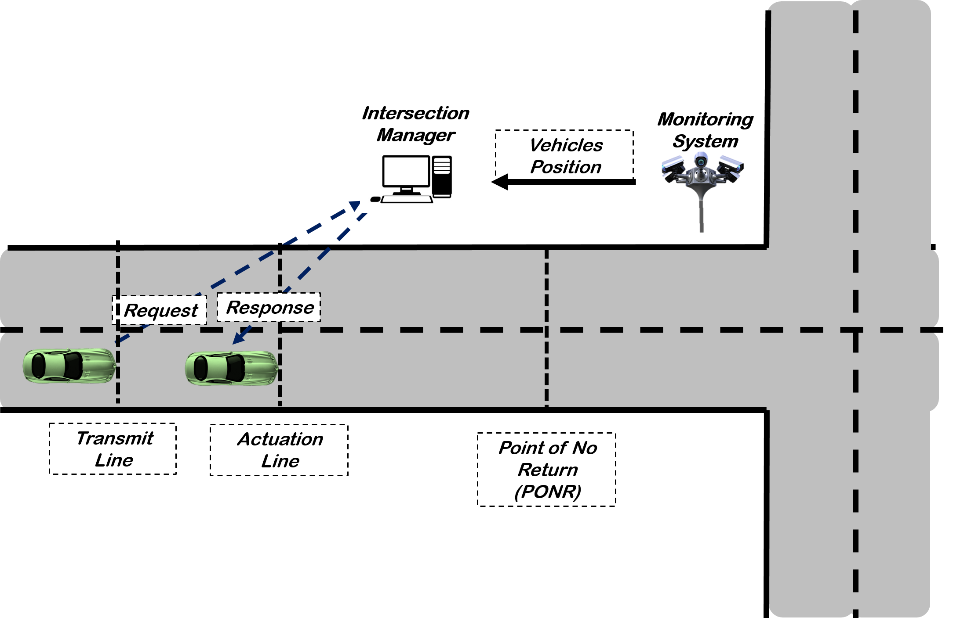
Need for Robustness
IM needs to handle non-ideal cases too. How?
Add a surveillance system
Can detect cars and send their position data to the IM
Notes:
So how could an IM handle non-ideal cases?
In what non-ideal cases would a surveillance system be useful?

Slide 6
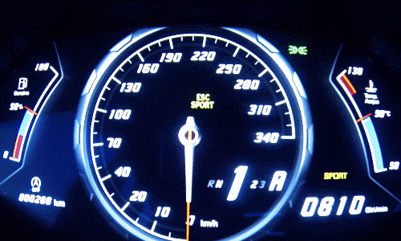
Fault Model: Rogue Car
Rogue car: starts to accelerate at an arbitrary and unknown acceleration in the range [a_{min}, a_{max}], starting at an arbitrary time t.
Examples of rogue cars:
Vehicle breakdown
Malicious vehicles
Human-driven vehicles
Vehicle which doesn’t communicate
Vehicle which violates IM’s instructions
Notes:
Consider the fault model of a rogue vehicle.

Slide 7
Problem Definition
Design an intersection management algorithm that will safely handle single rogue cars
Safe operation
A rogue car should not hit any controlled cars
Controlled cars should not hit any rogue car
Efficient, Graceful degradation
Intersection does not stop completely in the presence of a rogue car
Slow to a stop, and then once the rogue car is gone, automatically recover
Notes:
We have considered the aforementioned fault model in our design of an intersection manager. We guarantee safe operation in the presence of a single rogue car and ensure graceful degradation of the intersection in the presence of a rogue car.
talk about graceful degradation - reducing error, decrease speed

Slide 8
Reliable and Robust Intersection Management(R²IM)
Methodology, Experiments and Results

Slide 9
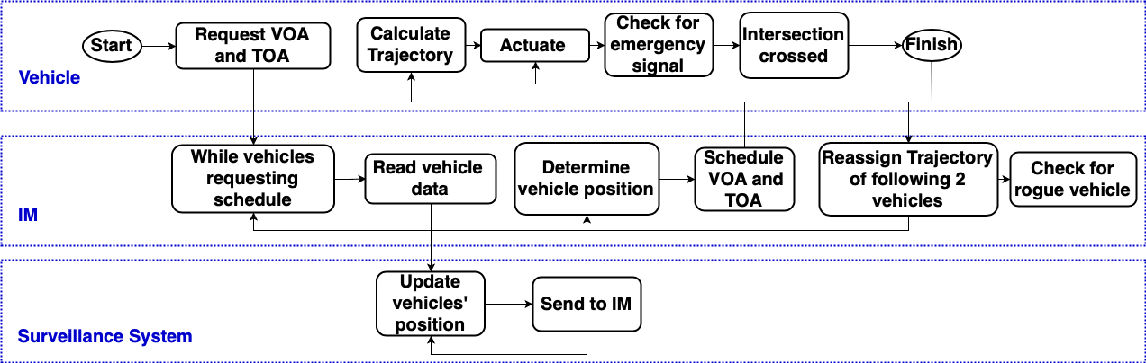
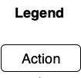
Normal Operation Flowchart
Notes:
The proposed IM’s normal operation proceeds as shown in the flowchart.
start by talking with IM and emergency stop
vehicles’ velocities are assigned based on previously scheduled vehicle velocities

Slide 10
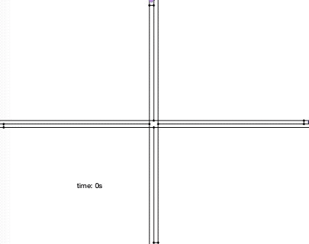
Reassignment of [VOA, TOA]
3 vehicles scheduled one after another
vehicle 1, vehicle 2, vehicle 3
Vehicle 1 exits the intersection
reschedule vehicles 2 and 3 earlier VOAs and TOAs
vehicle 2 assigned v=v_{max}
vehicle 3 assigned a new [VOA,TOA] based on constraints of vehicle 2
Each vehicle gets 2 reassignments of [VOA,TOA] in normal operation
Notes:
help
I wanted to revisit the concept of reassignment as previously mentioned. The reassignment of vehicles’ trajectories is as shown in the gif.

Slide 11

Normal Operation
Notes:
here we should what normal operation of an intersection looks like for R2IM.
talk about actuation line here

Slide 12
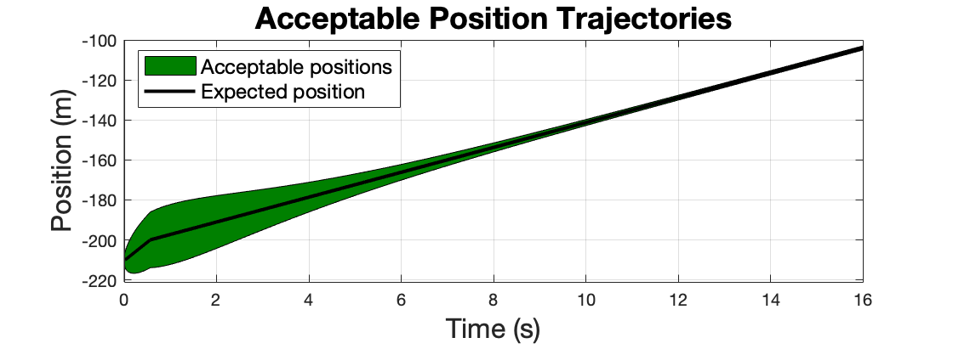
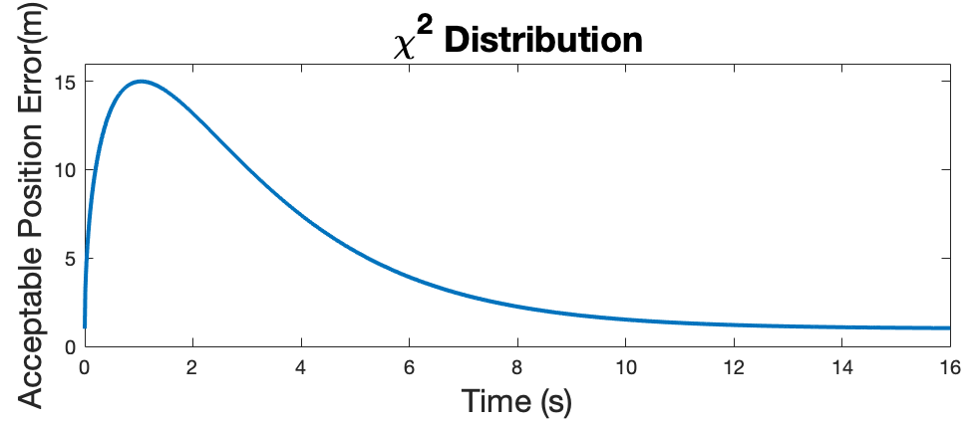
Rogue Vehicle
Account for position uncertainty
Exhaustively tested vehicle controller behavior
Notes:
help
The definition of a rogue vehicle qualifies any rogue trajectory that may occur. To qualify a vehicle as rogue, we first must identify whether or not it is violating the acceptable bound of error from the ideal position.

Slide 13
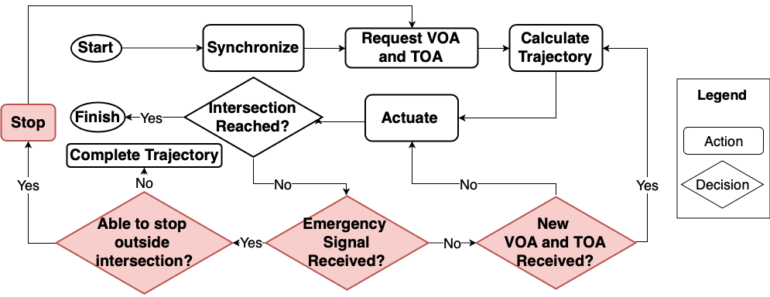
Vehicles Algorithm with Faults
Notes:
Intersection Reached not a decision
The flowchart of the vehicle operation in the presence of a single rogue vehicle is as follows.

Slide 14
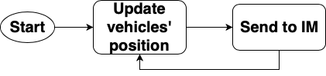
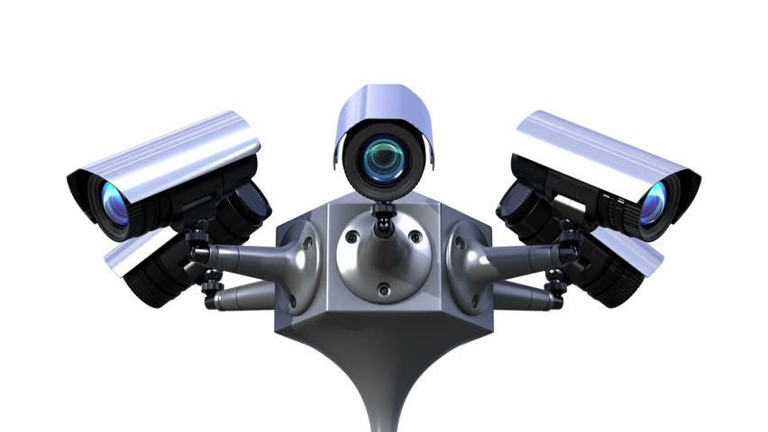
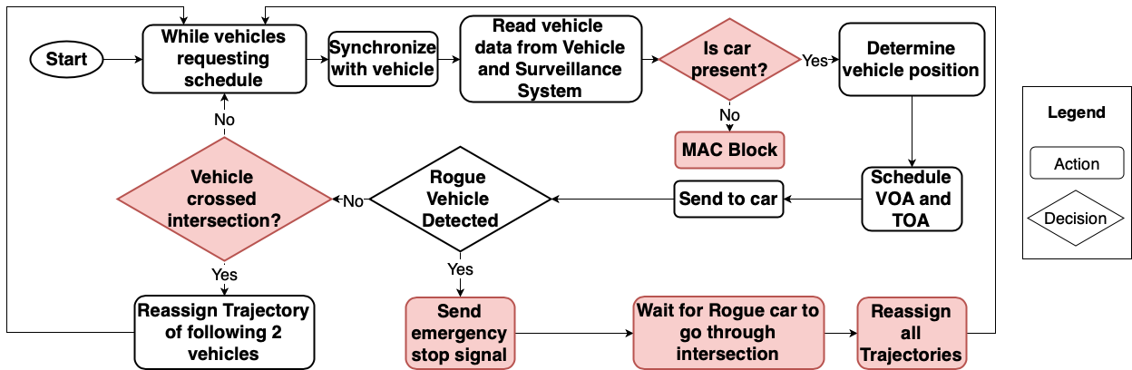
IM+Detection Algorithm

Slide 15
Single Rogue Vehicle Deceleration

Slide 16
Single Rogue Vehicle Acceleration

Slide 17
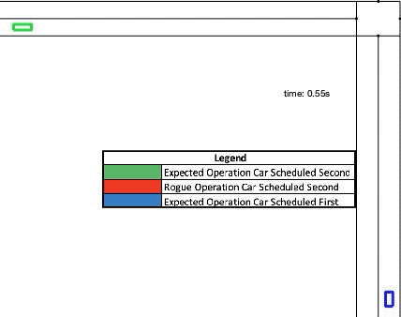
Proof of safety
Scenario:
Car 1 is scheduled to cross the intersection first
Car 2 goes rogue and accelerates, possibly hitting Car 1

Slide 18
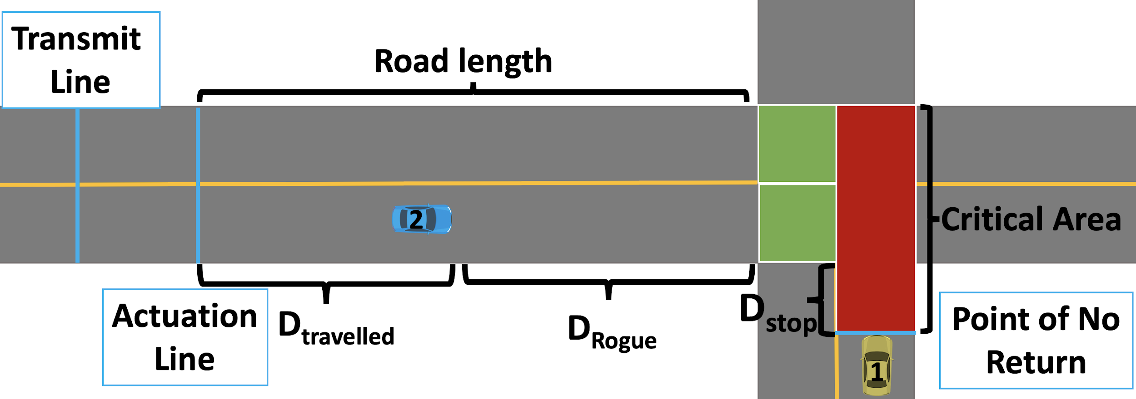
Proof of Safety
Definitions:
Point of No Return(PNR): If a car has crossed PNR, it cannot stop before entering the intersection
D_{Rogue}: The maximum distance Car 2 can travel in the time it takes Car 1 to cross from PNR to end of the intersection
Notes:
the fastest this car this car can physically travel is what is used for this calculation

Slide 19
Proof of Safety
Safety Property:
If Car₁ is past PNR, Car₂ cannot be inside D_{Rogue}
Find a VOA and TOA that satisfies this

Slide 20
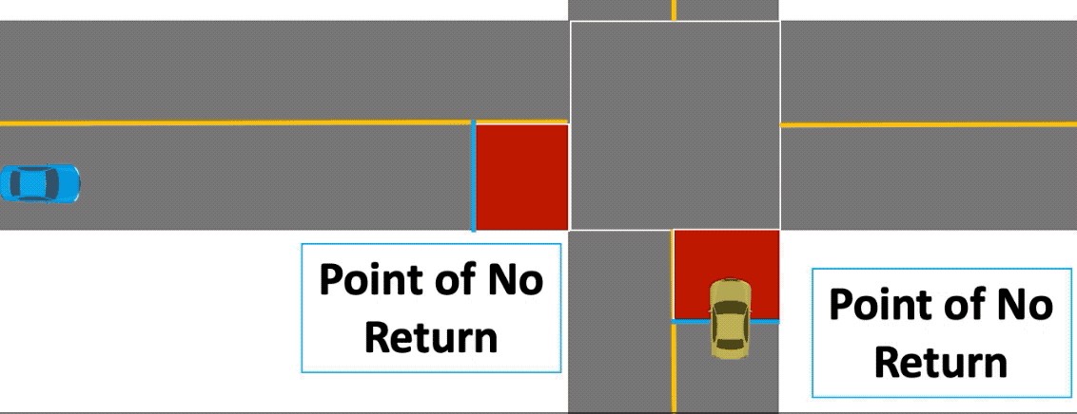
Rogue Car Deceleration - not as critical
When vehicle 1(yellow car) is decelerating out-of-control toward the intersection, vehicle 2(blue car) has enough time to stop outside the intersection
The IM doesn’t allow 2 cars to be past PNR at the same time

Slide 21
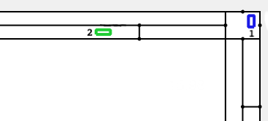
Testbed
An intersection simulator was developed in MATLAB.
General parameters used in the simulation:
road length=200m
distance between transmit line and actuate line=10m
intersection size=12m
vehicle length=5m, vehicle width=2m
v=[0,20]m/s, a=[-8,5]m/s²
detection delay=worst-case communication delay+time to detect=0.5s
initial velocities and entry times are randomly selected.
Notes:
In summary, these are all the worst-possible situations for each attribute
know DSRC - dedicated short-range communication

Slide 22
Testbed for Correctness Experiments
2 vehicles simulated
Vehicle 1 scheduled before Vehicle 2
Case 1: Vehicle 2 accelerates out-of-control
Case 2: Vehicle 1 decelerates out-of-control
R²IM and RIM tested randomly - The input values to the simulation include
the assigned VOA of the first car randomized between [5,v_{max}-2]
the t_{entry2} of the second car is randomized between [0,TOA₁]s
the failure time was randomized between [0,TOA₁]s
R²IM tested using exhaustive approach
Failure time tested between [0,TOA₁]s with a step of 0.1s
Initial velocities are randomly selected

Slide 23
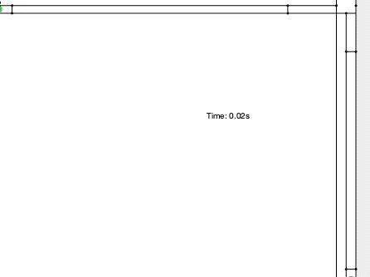
Results: Acceleration Case Study
Vehicle 2 accelerates out-of-control
Vehicle 1 safely comes to a stop
waits for vehicle 2 to cross intersection
vehicle 1 continues when safe

Slide 24
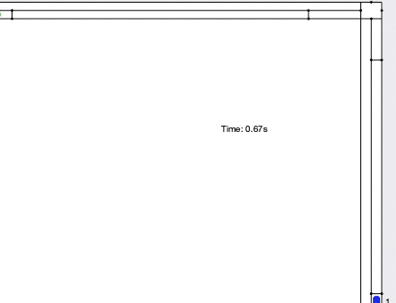
Results: Deceleration Case Study
Vehicle 1 decelerates out-of-control
Vehicle 2 safely comes to a stop
waits for vehicle 1 to cross intersection
vehicle 2 continues when safe

Slide 25
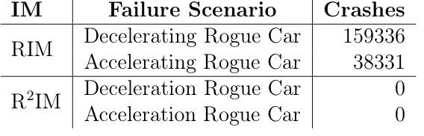
Results for Correctness Experiments
Number of crashes in 1,000,000 iterations of the simulation
Exhaustive study of R²IM resulted in zero crashes

Slide 26
Testbed for Throughput Experiments
Throughput simulation
2 intersection management schemes tested
RIM
R²IM
50 vehicles simulated
Varied flow rates between [0.1,2] cars/lane/second with a step of 0.1 cars/lane/second
The same initial inputs from the correctness simulation were used
the assigned VOA of the first car randomized between [5,v_{max}-2]
the t_{entry2} of the second car is randomized between [0,TOA₁]s
no faults injected
Four-way, one-lane intersection was used for comparison

Slide 27
Results for Throughput Experiments

Slide 28
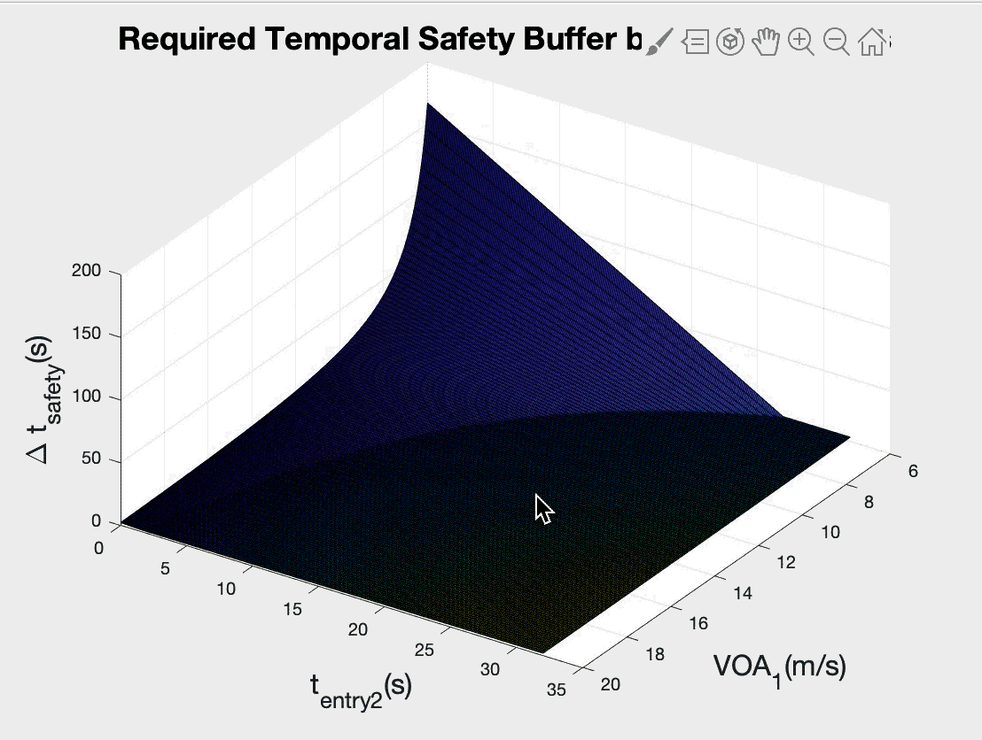
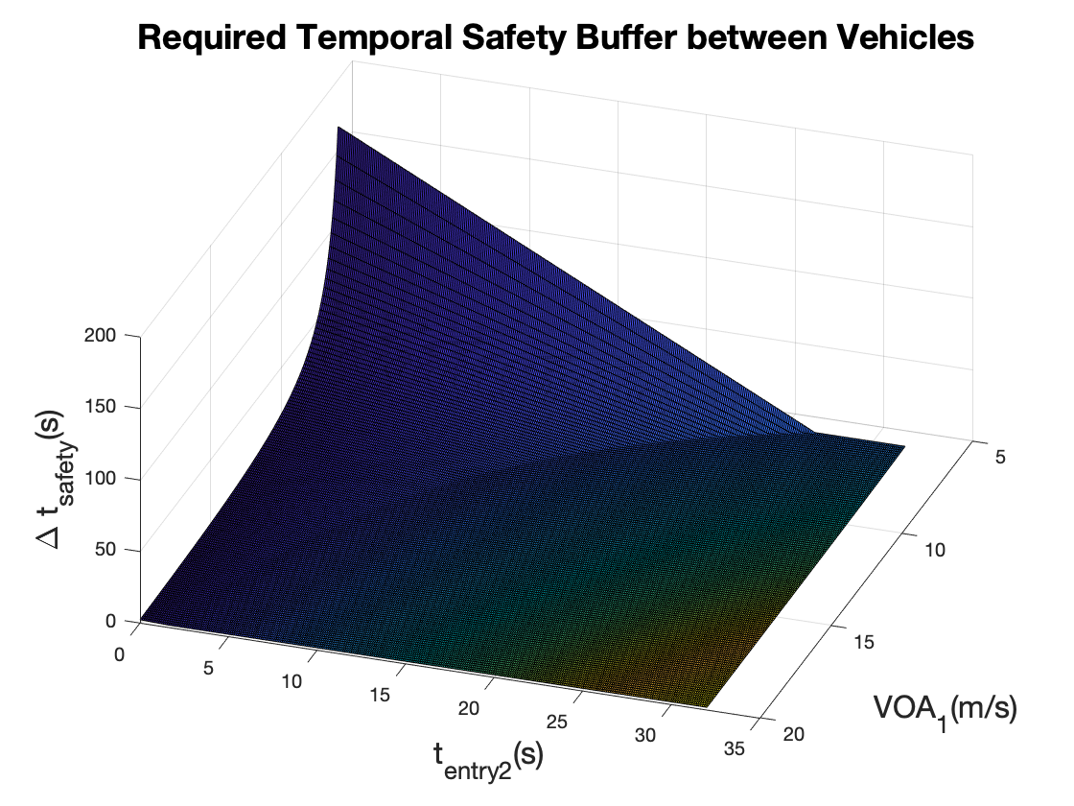
R²IM Throughput Analysis
The temporal safety buffer is the timing between cars entering the intersection.
∆t_{safety}= temporal safety buffer between vehicles
Throughput decreases when the temporal safety buffer increases.
R²IM calculates the temporal safety buffer based on arrival to PNR rather than arrival to the intersection, necessarily increasing the temporal safety buffer and causing throughput to decrease.
The temporal safety buffer between vehicles 1 and 2 depends on two variables:
t_{entry2}= entry time of vehicle 2
VOA₁= velocity of arrival of vehicle 1
Notes:
help
RIM has a smaller temporal safety buffer than R2IM.

Slide 29
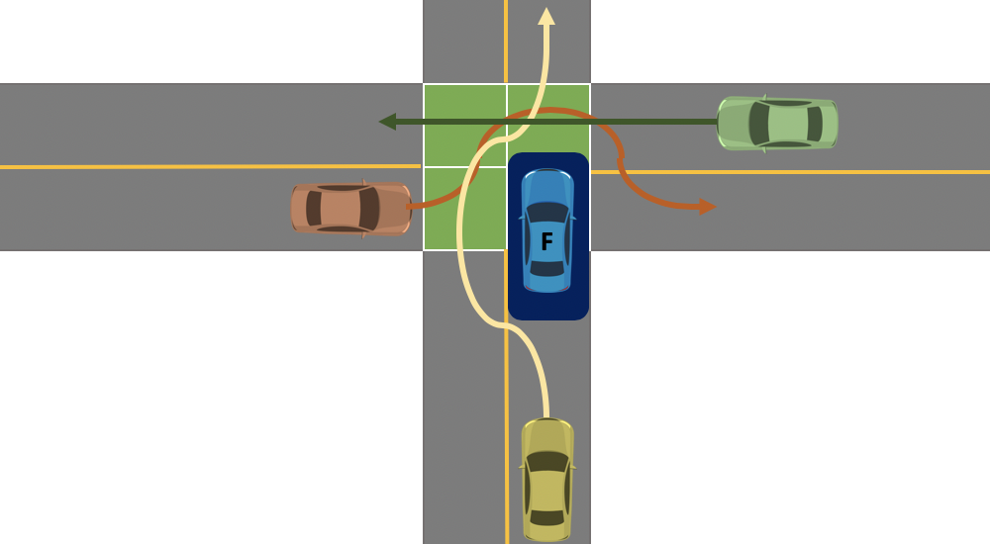
Future Work
Consider more fault models
More than one rogue vehicle at a time
Multiple lanes
Security concerns DoS attacks
Incorporate road cautions
Bicyclists, pedestrians, construction, etc.
Merge around broken down vehicle
Notes:
if DoS attack happens, there should be another mechanism to stop vehicles in an emergency situation
swerving is a rogue behabior R2im considers - may be too conservative

Slide 30
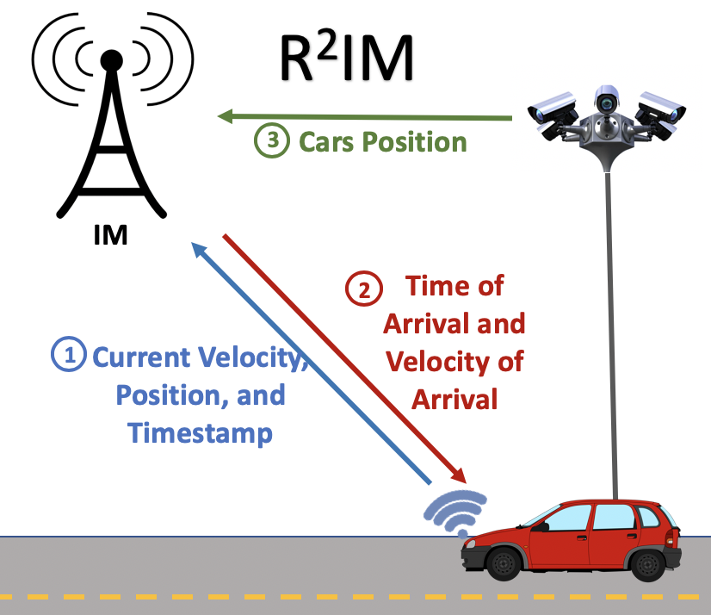
Conclusion
We proposed an intersection management technique that is resilient against single rogue cars at a time.

Slide 31
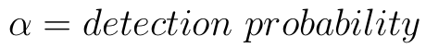
Accurate Positioning Technique: Data Meshing
Surveillance System data=Detect_Data,
where,
CAV data=V_Data
IM_Data= scheduling data
V_ID=vehicle whose position is being calculated
Notes:
confidence

Slide 32
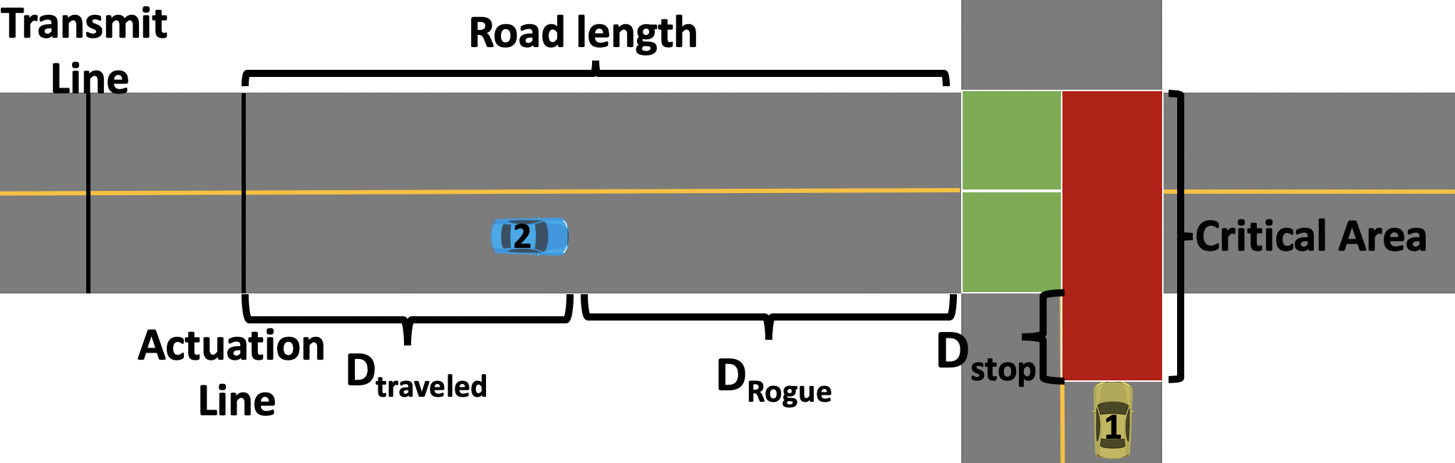
Calculating Safe Scheduling
Inputs: TOA1, VOA1
Objective: Calculate the TOA and VOA for the Blue vehicle assuming the yellow vehicle has already received a TOA and VOA.
[VOA₁,TOA₁] = vehicle 1 VOA and TOA
[VOA₂,TOA₂] = vehicle 2 VOA and TOA
Output: TOA2, VOA2

Slide 33
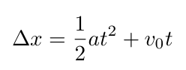
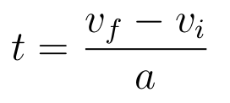
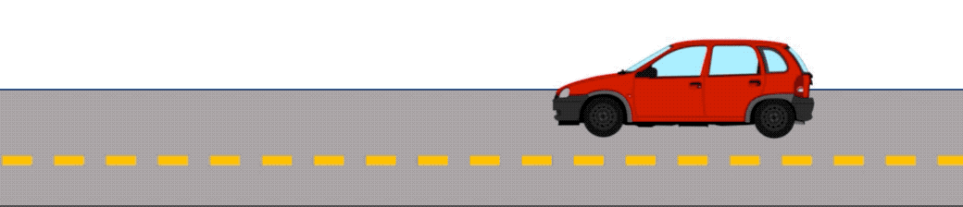
Vehicle model
Kinematic equation for the vehicle is
a is acceleration, v is velocity, t is time, Δx is displacement, v₀ is the initial velocity, where
Notes:
we project the 2D model into a 1D model
Note the equation to obtain time and distance

Slide 34
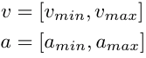
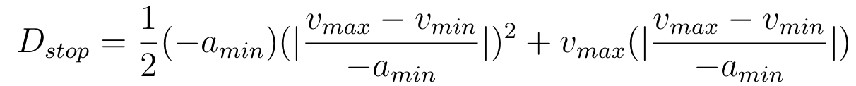
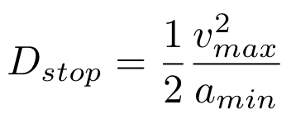
Calculate Braking Distance
Given a range for the speed and acceleration of all vehicles, we have:
Worst-case where vehicle is traveling v_{max}m/s, the braking distance is
Notes:
only talk about global acceleration, not global velocity

Slide 35
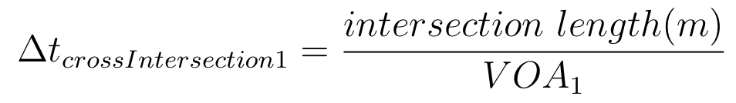
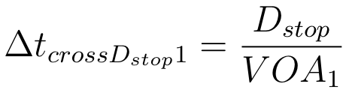
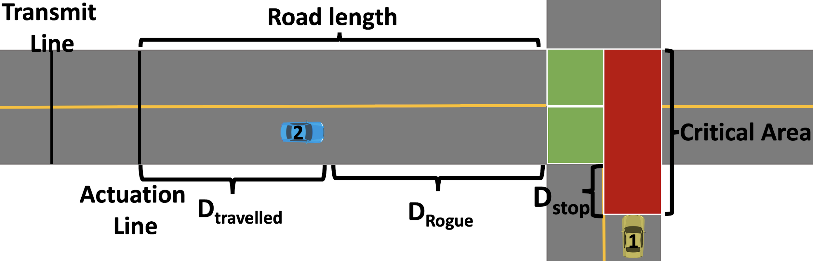
Calculate Time to Cross the Critical Area
The yellow vehicle takes Δt_{crossIntersection1} to cross the intersection area:
The yellow vehicle takes Δt_{crossDstop1} to cross the D_{stop}:
In total, the cross time for the Critical Area is:
Notes:
dstop+intersection length/VOA1 is all that is needed

Slide 36
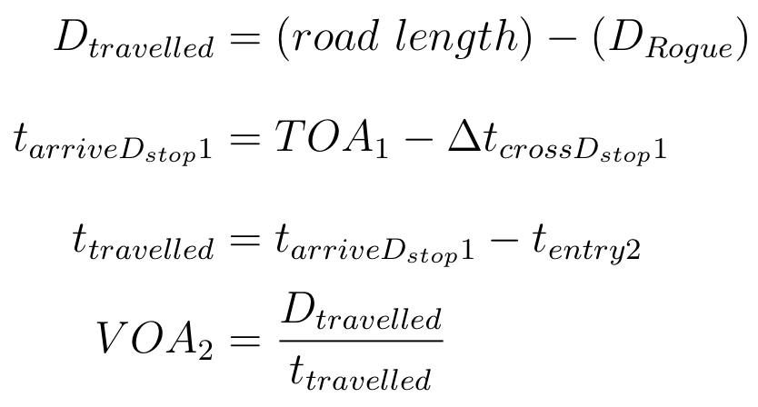
Calculate the Rogue Distance
At the same time, the blue (rogue) vehicle may travel at maximum velocity in the worst-case:
Assuming the detection has Δt_{delay} time units latency.
Therefore, the remaining distance for the blue car to travel is
We want the blue car to be at least D_{Rogue} m away from the intersection when the yellow car is at the point of no return.
Notes:
definition for drogue in english- no one can be inside drogue except for one car

Slide 37
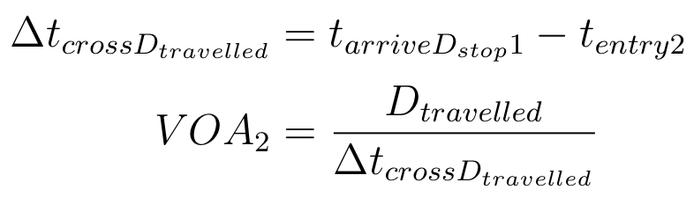
Calculate VOA₂
Recall the time to cross the D_{stop} was
We find the timestamp time at which the yellow car reaches the point of no return:
The blue car travels the remaining distance (D_{traveled}) in Δt_{crossDtravelled}:
The assigned velocity to the blue car should be set as:
Notes:
make objective clear - calculate VOA2

Slide 38
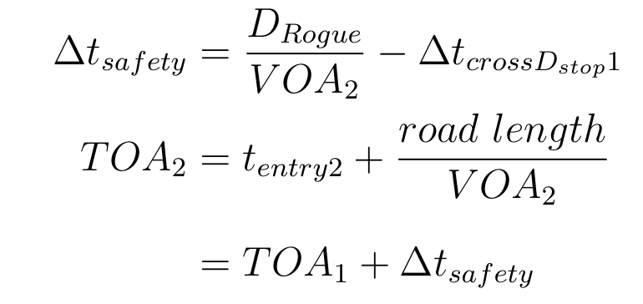
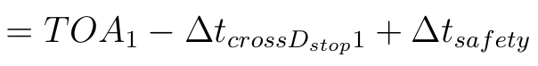
Calculate TOA₂
The required temporal safety buffer between arrival times of vehicle should be:
Accordingly, the assigned time of arrival to the blue car is:
Notes:
key intuition in words

